Slide 1
Social Enterprise in Universities: Experiences from Abroad

Slide 2
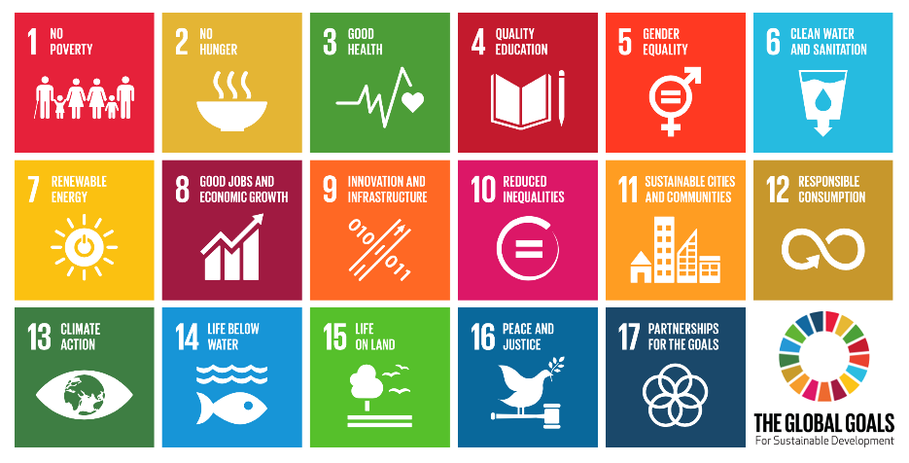
The Challenge
UNCTAD estimates annual funding gap of $2.5 trillion to achieve the SDGs by 2030
“It is imperative to implement innovations that can divert private capital towards development objectives to help bridge the SDG financing gap.”
- United Nations Under-Secretary-General and Executive Secretary of ESCAP Dr. Shamshad Akhtar

Slide 3
The Opportunity
Impact investing is a fast growing and new approach to economic development
Impact Investing
PHILANTHROPHY
THEMATIC INVESTING
SUSTAINABLE INVESTING (ESG)
SOCIALLY RESPONSIBLE INVESTING (SRI)
MAINSTREAM INVESTING
Fully oriented to positive impact
Investment in chosen sectors
Positive screening
Negative screening
No consideration of impact
EXPECTED GROWTH
World Economic Forum expects an investment of $500 billion by 2020 in impact businesses
FINANCIAL MAJORS ALL IN
Blackrock, Bain, BNP, Goldman, Zurich Insurance, AXA are now investing in impact.
SHIFT IN THE WAY WE DO BUSINESS
Focus on triple bottom line
EVOLVING AND ENABLING LANDSCAPE FOR INVESTMENT IN INDIA
$5.2 bn invested in India in the last 6 years; $10 bn projected for 2025
Regulation for Social Venture Capital Funds within AIF
Priority Sector Guidelines provide additional opportunity for growth- JAM
Enabling Ecosystem for youth led innovation

Slide 4
The Numbers
Impact sector is powering ahead with a robust CAGR
Growth in Investments
Case for Growth in Social Innovation
How do we further promote growth in social entrepreneurship?

Slide 5
Pillars of Social Innovation
The Pillars
In 2012, more than 89% of Indian social enterprises were less than 10 years old and 88% of them were in pilot, start-up, or growth stage.
What is the way forward?
A
K
Access Innovation
E
Keep Measuring
P
Ecosystem
T
Policy and Governance
Technology

Slide 6
The Pillars
ACCESS INNOVATION:
Reimagine the role of university as change maker.
How can social innovation and entrepreneurship be promoted at the university level?
To find unique and sustainable solutions to the social issues the world is currently facing there needs to be a push towards student led initiatives and innovation.
Linking Curriculum to explore real world challenges.
Leverage technology to reach students outside the realm of formal education.
Promote collaboration between private, public and academic communities.
Introducing exclusive full-time and part-time programs in social entrepreneurship.
Creating incubators and advisory councils to support and guide new ideas.
Facilitate an environment for active debate and discussion on social issues

Slide 7
The Pillars
KEEP MEASURING:
Shifting focus to delivering outcomes
Case for innovative models for facilitating a focus on outcomes and monitoring:
Impact Bonds: Moving towards ‘Mission-Oriented Investing’
Impact Bonds are pay for success financing instruments used to link socially conscious private investors with enterprises that aim to deliver social outcomes.
Impact Bonds bring together impact investors, philanthropists, and social businesses on a common platform, where in social business gets access to zero cost financing.
Impact Bonds promote a culture focused on achieving pre-identified outcomes.
Allows Social Enterprises to prioritize on outcome delivery.

Slide 8
The Pillars
ECOSYSTEM:
Impact Investing a lucrative option for mainstream economy.
Funding remains the single biggest challenge faced by social enterprises
Source: British Council 2016
GRAMEEN CAPITAL INDIA
( GCI )- Capital with a Conscience
GRAMEEN CAPITAL INVESTMENT ADVISORS
GRAMEEN IMPACT INVESTMENTS INDIA
EQUITY FUND
SOCIAL STOCK EXCHANGE / CROWD FUNDING PLATFORM
Advisory Practice
NBFC/ Debt financing

Slide 9
The Pillars
POLICY and INSTITUTIONAL FRAMEWORK
The focus of universities in guiding students towards social causes is mostly through rewarding active participation.
For example, in Delhi University students have to devote 120 hours in the National Service Scheme to be awarded the graduate degree.
A new wave of social progress and development can be catalysed by promoting and supporting budding Social Entrepreneurs.
Youth focused initiatives like Jagriti Yatra, Yuva Prerna Yatra, Gramya Manthan and Earth-Shastra in India aim to raise awareness about social issues.

Slide 10
Special Case
INDIA- USHERING IN A NEW WAVE OF CHANGE.
Training changemakers of tomorrow:
Ashoka University: Ashoka envisions an “Everyone a Changemaker” world. Entrepreneurs in Residence (EiR) program to provide a platform for aspiring entrepreneurs in the fellowship program.
School for Social Entrepreneurs (SSE): SSE has partnered with PwC which selects and subsequent sponsors the students forthr program.
MBA in Social Entrepreneurship offered by The Narsee Monjee Institute of Management Studies (NMIMS).
Catalysing Change:
Centre for Innovation Incubation and Entrepreneurship (CIIE), IIM A: CIIE engages with startups in social sectors.
Rural technology and business Incubator, IIT Madras: Offers mentorship, infrastructure, preliminary funding and access to networks, for startups.

Slide 11
Special Case
A SPECIAL CASE
Jindal Centre for Social Innovation + Entrepreneurship
A Global Impact Social Centre
Founded in 2014 to provide training and support innovation through incubation and active support for research to further social development and entrepreneurship.
In partnership with Middlesex University co-created the Future Learn Social Enterprise Program, a massive open online course (MOOC).
Since October 2016, the Future Learn Social Enterprise Program has helped14,000+ learners from over 159 countries.
JSiE offers guidance and resources to early-stage startup entrepreneurs through its incubation centre.
JSiE partnered with Tibetans in Exile to help support and promote local business initiatives. They host early-stage entrepreneurs from the refugee community for a five-week residential pre-incubation program.
JSiE organizes an online ‘International Social Innovation Challenge’ in which the winning idea gets mentorship from the extensive JSiE network.
Incubation partner to StartupWave, a virtual incubation platform conceptualized by Intellecap in partnership with DFID and GIZ.

Slide 12
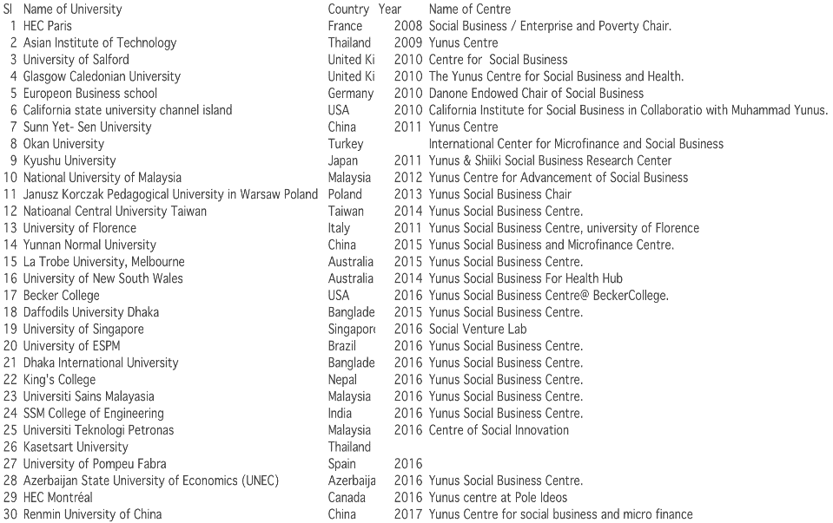
Special Case
List of Yunus Social Business Centres

Slide 13
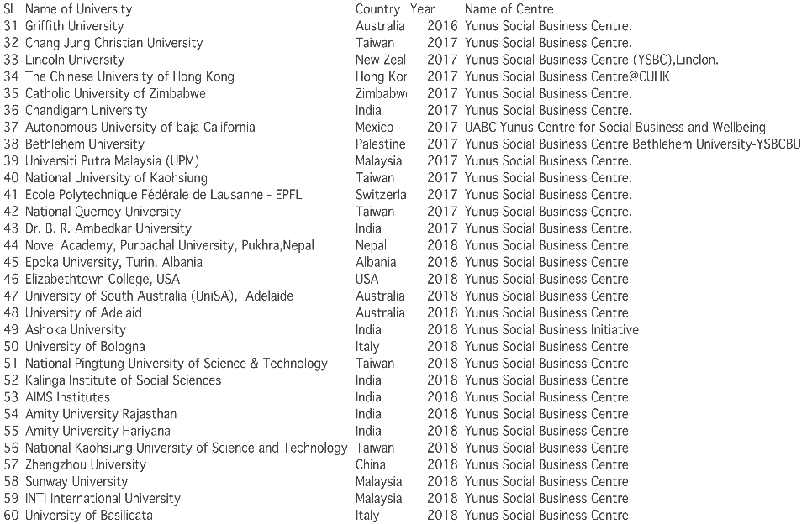
Special Case
List of Yunus Social Business Centres

Slide 14
The Pillars
TECHNOLOGY
Universities need to incorporate the fast evolving technology landscape into their curriculum to ensure the students are better prepared to leverage the opportunity it presents.
Massive Open Online Courses(MOOC’s) to reduce barriers to accessing information.
Creating Web Platforms to facilitate seamless integration and transfer of knowledge across universities, governments and private stakeholders.
Leverage blockchain to allow safe, transparent and easy access to information.
Blockchain can allow cost-efficient and continuous traceability of benefits received by the beneficiary consequently ensuring effective monitoring and measurement of outcomes.

Slide 15
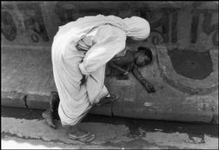
Carpe Diem

Slide 16
Thank you
“The fact is that there is plenty of money in any country to lend money to the poor. It is all a question of mobilizing it and making it available to the poor. Grameen Capital India will facilitate access to local capital markets for Indian MFIs.”
Prof. Yunus, 2006 Nobel Laureate,
in “Creating a World Without Poverty”

