Slide 1
SUCCESS STORY
By
Dr Izza Arsyika Abdul Rahim
Secretary

Slide 3
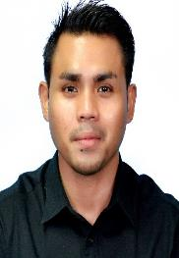
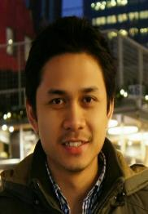
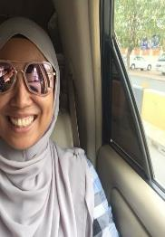
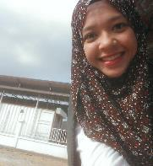
Our Team Members
Dr Wan Abdul
Hannan
Dr Lutfi Fadil
Lokman
Dr Izza Arsyika
Dr Inah Ja Abd
Jalil
Co founder and CEO
Founder and Chief Strategist
General Secretary
Chief Operating Officer

Slide 4
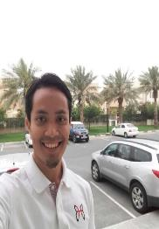
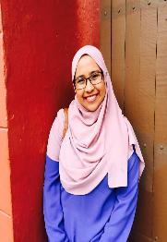
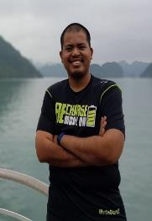
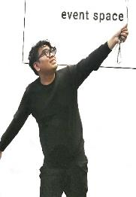
Our Team Members
Khairul Izwan
Aziz
Izzati Inani
Majid
Muhammad
Akmal
Yusri Aiman
Head of Finance
Finance Officer
Head of Marketing
Marketing Officer

Slide 5
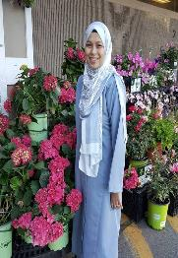
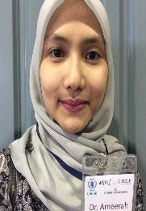
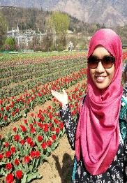
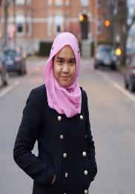
Our Team Members
Dr Ameera
Syafiqah
Dr Sarah
Shahidan
Asmah Shahidan
Dr Kamaliah
Jalalonmuhali
Assets Management Officer
Marketing Officer
Volunteer Officer
Finance Officer

Slide 6
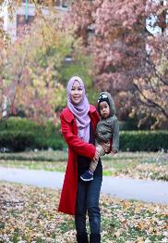
Our Team Members
Dr Fahimah
Public Relation Officer

Slide 7
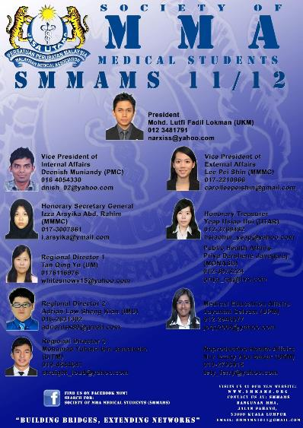
How did HBB come about?

Slide 8
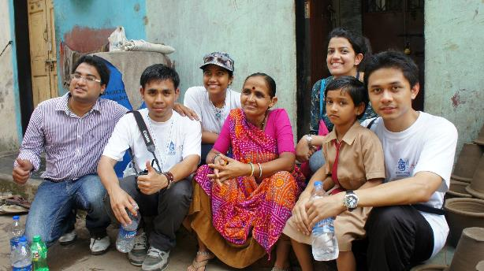

Slide 9
Opportunity came

Slide 13
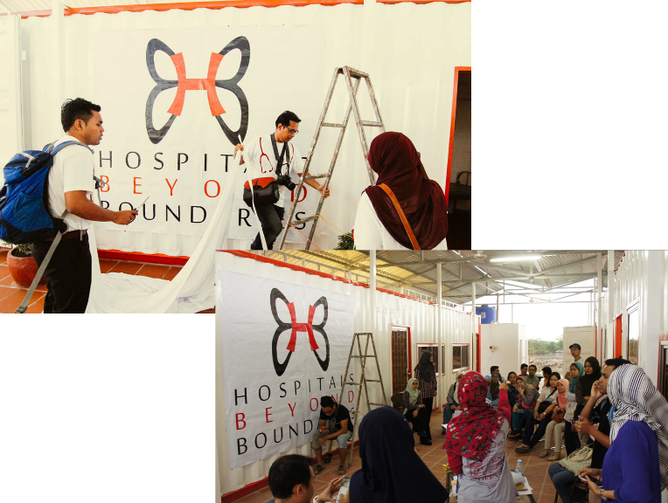

Slide 14
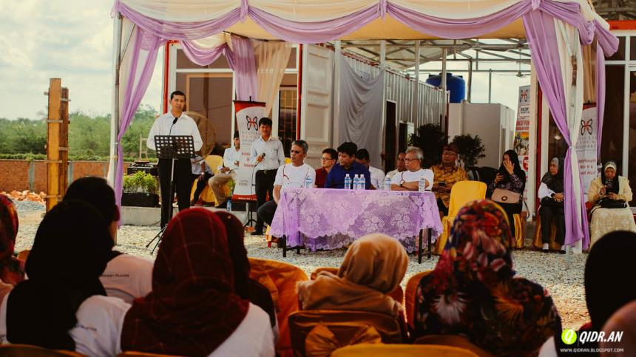
LAUNCH OF HBB CLINIC, PHNOM PENH, CAMBODIA 2014

Slide 15
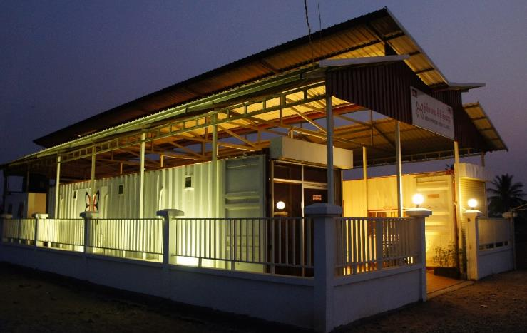
HOSPITALS BEYOND BOUNDARIES CLINIC, PHNOM PENH, CAMBODIA

Slide 16
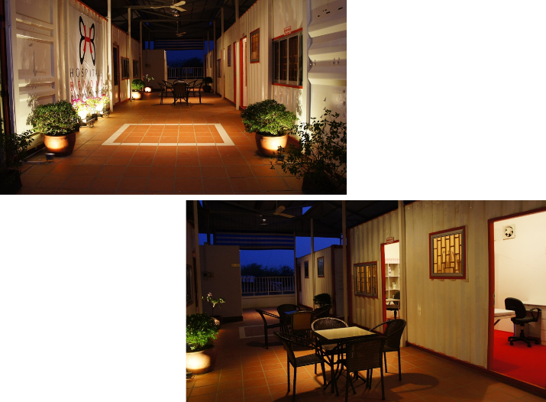

Slide 17
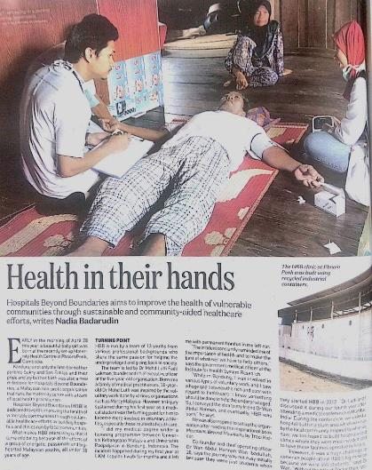

Slide 18
THE BIG DREAM – MATERNAL HEALTH CENTRE

Slide 20
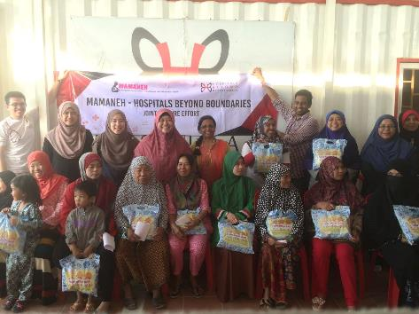
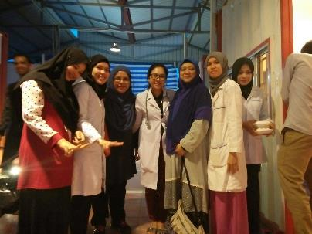
Empowering the community

Slide 21
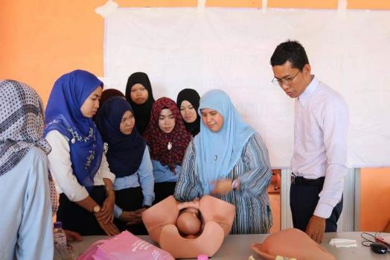
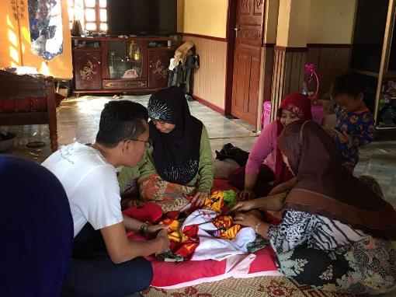
MIDWIFERY CLASS and HOME VISITS

Slide 22
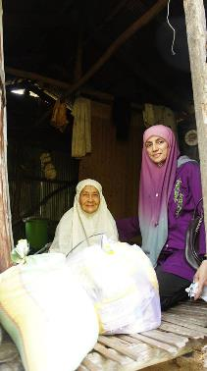
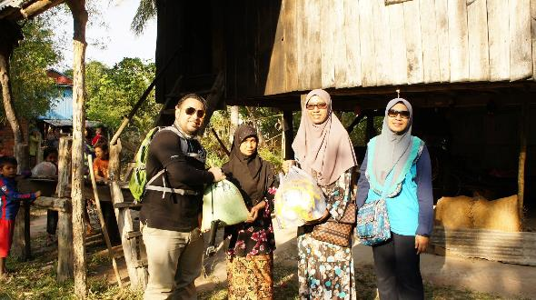

Slide 23
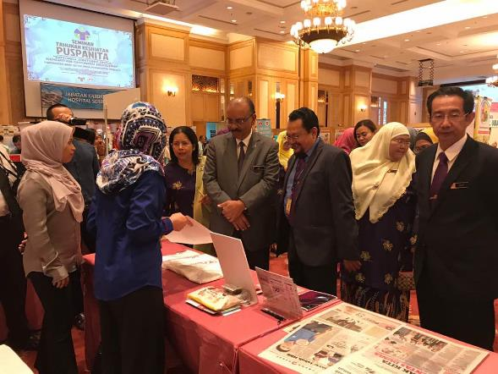

Slide 25
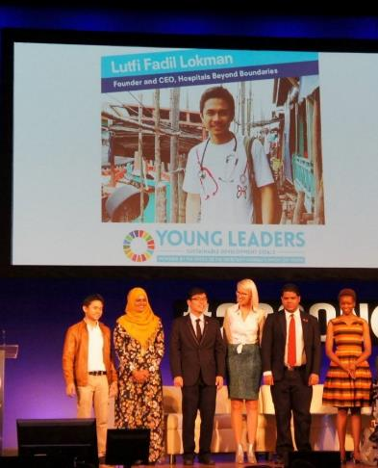
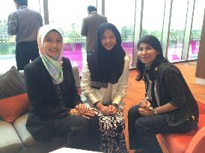
2016- Dr Lutfi recognized as United Nation Young Leader

Slide 26
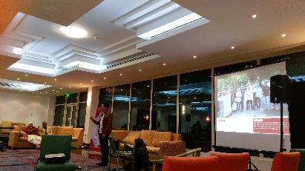
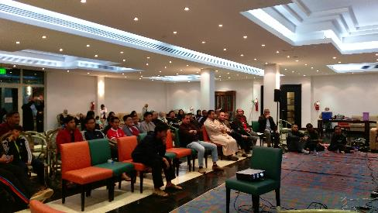
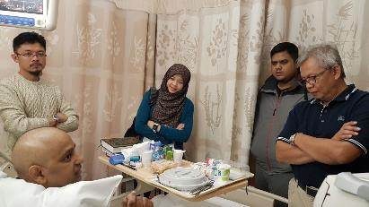
HBB supporters in Qatar

Slide 27
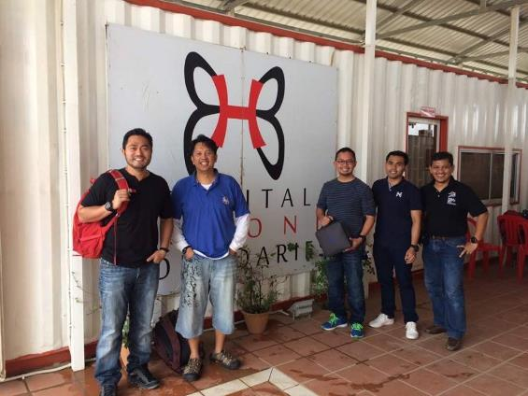

Slide 28
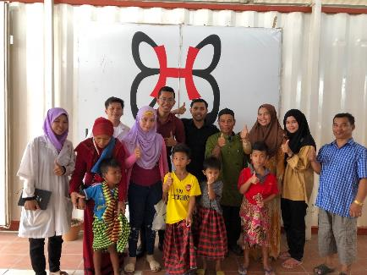
FIRST HERNIAL REPAIR SURGERY

Slide 29
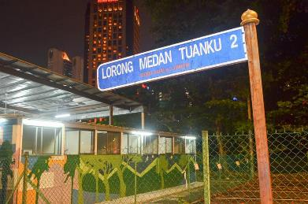
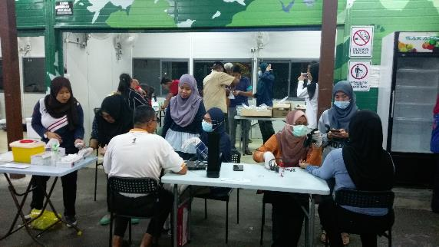
HBB MOBILE CLINIC

Slide 31
MAMANEH – Malaysian Association of Maternal and Neonatal Health

Slide 32
HBB Timeline
2012
2013
2014
2015
Establishment
Engagement with local community
Fundraising activity
Establishment of HBB Clinic
22nd May 2012 as an NGO
HBB Mobile Clinic

Slide 33
HBB Timeline
2016
2017
2018
2019
Dr Lutfi recognized as United Nation Young Leader
1st Baby born and started hernia repair
Dr Hannan received Young Achiever’s Award for Entrepreneur of Excellence from Binary University
Cataract Surgery
Cleft lip repair
And etc
Expanded to Maternity Centre

Slide 34
HBB Worldmap
Outpatients treated
Low risk Deliveries
HBB Kuala Lumpur & Phnom Penh
2200
13
Hernia repair
Circumcision
23
57
Volunteers recruited
Outreach
projects
200
30

Slide 35
Thank you
www.hbb.org.my

