Slide 1
Innovative Communication Tools for Social Enterprise
Part 2

Slide 2
Overview
First session by Vivian Lines
Source Money
Save Money
Run Your Enterprise
Be Better Known
Awards and Grants

Slide 3
Overview
Second session
Owned Media
Earned Media
Case Studies by Grub Cycle

Slide 4
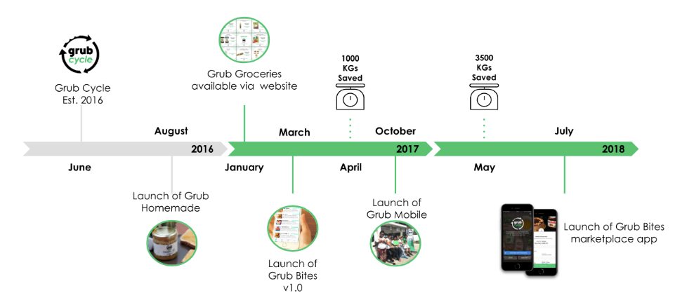
Introduction

Slide 5
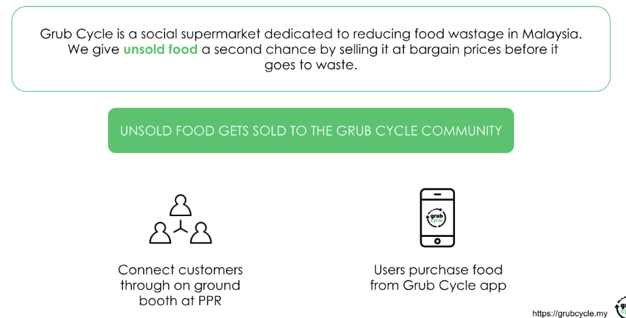
Introduction

Slide 6
Bootstrapping
How to achieve growth with a limited budget

Slide 7
Bootstrapping
Paid marketing works, is great and suitable for those who have money...
But until then startup founders need to figure out what they can do with little or no money at all in order to get the traction that will lead to revenue or investment that can be spent on marketing.
This section focuses on unleashing the full potential of Owned and Earned media.

Slide 8
Owned Media
Any asset you have (almost) free reign to use.
Your phonebook, email list and social media followers
Your company website and social media.
Your physical space and assets.
Your products.
Your events and gatherings.
Your vehicles.
Your employees.

Slide 9
Earned Media
A 3rd party or platform, where you’re hoping to get non-paid exposure.
That event your customers love.
That blogger that covers your industry.
That publication that your customers read.
That influencer your customer trusts

Slide 10
What were usually hoping for…
Any marketing effort that helps us increase:
The chances of being seen / noticed
The spread of our message
The likelihood of converting a potential customer
It depends on your goals!

Slide 11
One Core Principal : Add Value!
To do this, you need to answer:
For better owned: Who is your target? What does that target see as value?
For better earned: Who is your 3rd Party’s target? What does that target see as value?

Slide 12
Case Studies
Newsletter
Blogs
Collaterals
Events
Media Interviews
Promo Swops
Always Ask Questions

Slide 13
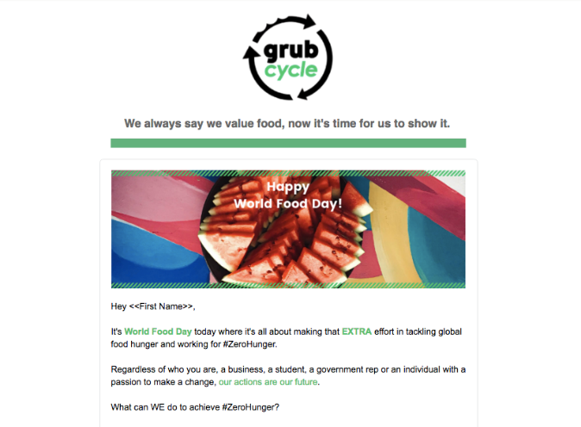
Newsletter

Slide 14
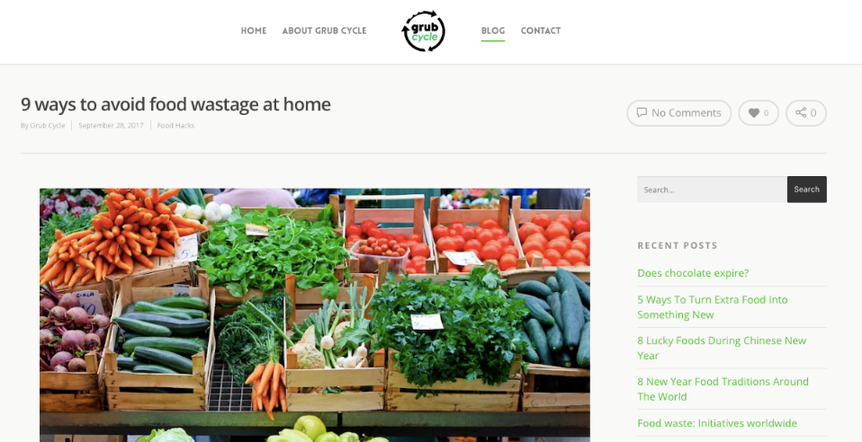
Blogs

Slide 15
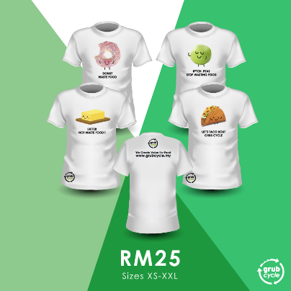
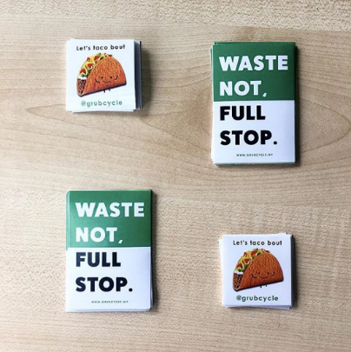
Collaterals

Slide 16
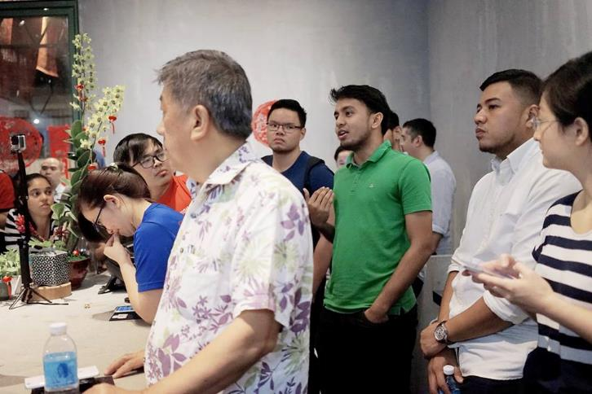
Events

Slide 17
Media Interview

Slide 18
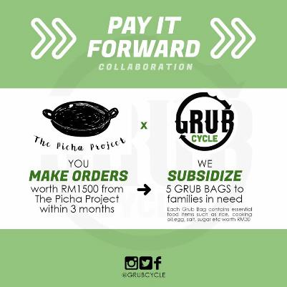
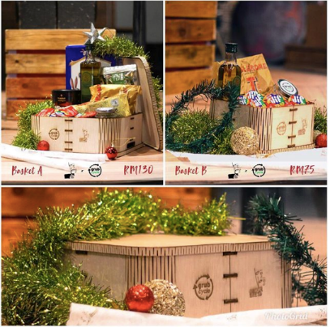
Promo Swops

Slide 19
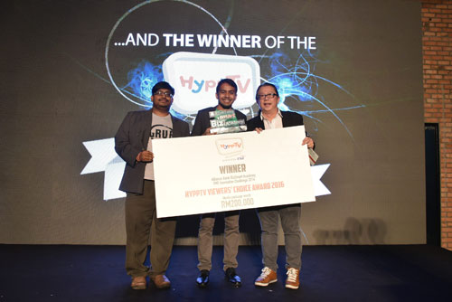
Awards & Grants

Slide 20
Owned Media Cost : Time & Sweat
Anything you already have which can command
an audience.
Your phonebook, email list and social media followers (friends & family).
Put your knowledge/experience into a blog, whitepaper, e-book, infographic or slideshare for people to find you.
Your company website and social media. Write well, make it shareable and ask people to help.
Your physical space and locations (walls, windows, counters, buildings)
Your products (packaging, receipts, bill statements, tags, stickers)
Your events and gatherings
Your vehicles (Cars, Vans.. Even those of friends and family)
Your employees
Your happy customers (incorporate referral)
Your everyday communication collaterals (emails, letters, envelopes)
You (apron, cap, notebook, laptop, t-shirt)
You calling people, 1-2-1 selling, networking at events (invade events your customers are likely to attend)

Slide 21
Earned Media Cost : Charm
Any third party mentions you can get without paying.
Press Release for Media (downloadable from your website or sent to them)
Media interviews (Have a compelling story, be open and inviting)
KOL’s (Build relationships and favors with influencers to share a social media post or a video)
Guest Blogging or Podcasts (leverage on someone else's audience)
Promo swops
App markets/Startup databases
Joining as a speaker or panel member at events
Enter into startup/SME business competitions (especially those that have media coverage )
Become a co-organizer of an event by helping out; barter resources. (venue space, emcee, video, promotions etc.)
Always ask questions at events and introduce yourself as from Company “X”
Be active in online groups relevant to your target audience (FB, LinkedIn etc.)

Slide 22
Summary
Tools (Maximise Free & Trial Version)
Owned Media (Time & Sweat)
Earned Media (Charm)
Great Communication will lead to Great Marketing (Internal & External)

Slide 23
Together we can achieve
the goal of #ZeroFoodWaste
Questions?
CONTACT US
redza@grubcycle.my
+6012-2188110

