Slide 1
Commercialising
Social Businesses-
Insights from myHarapan

Slide 2
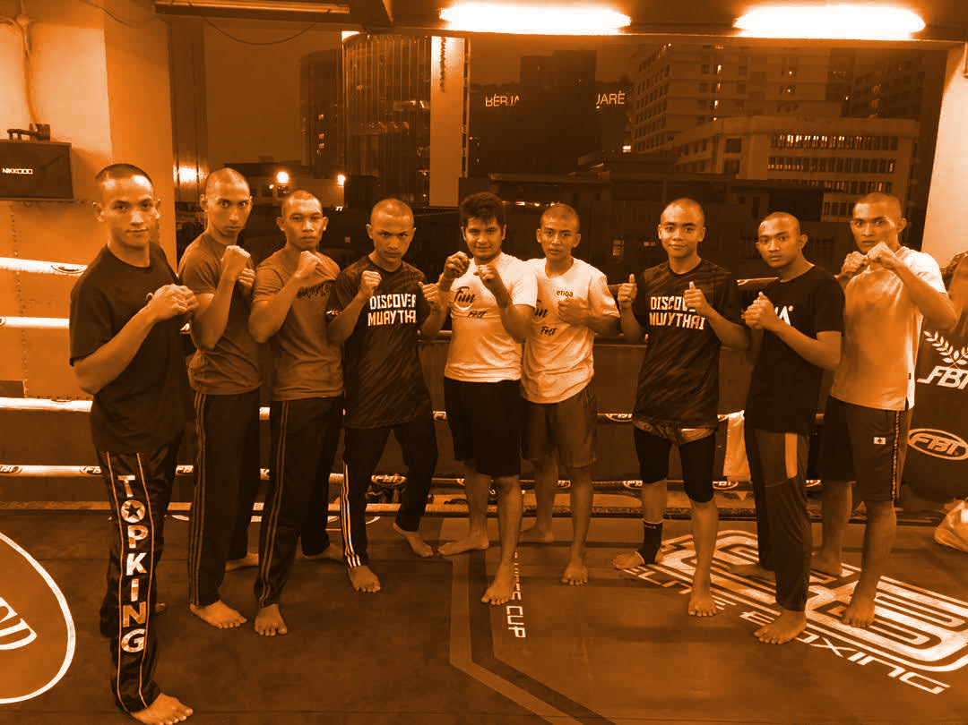
Youth Trust Foundation
Accelerate the growth of impactful youth in social initiatives across all sectors, leading to sustainable social businesses serving Malaysia (and the region).

Slide 3
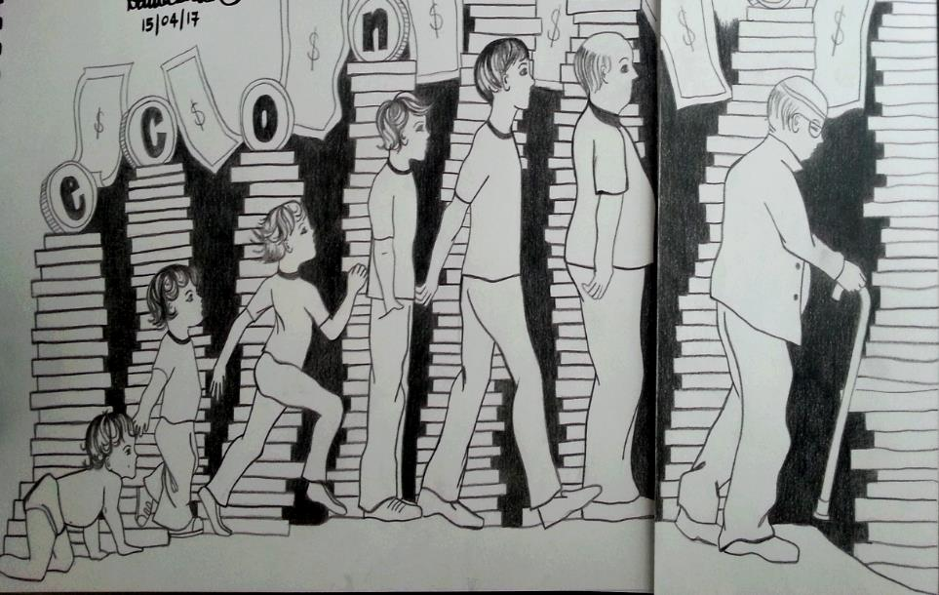
Our League of Superheroes
Social Venture Fund
80 social business/enterprise proposals received
5 social business/enterprise ideas invested in
16 Impact Driven Enterprises for Microdeployment
RM 1mil over disbursed
Youth Action Grants
155 social projects awarded grants
465 entrepreneurs coached and mentored
3100 Malaysian beneficiaries impacted
RM 1.179 million disbursed
Youth Beneficiaries
• 27,000 youths reached
• 4000 youths trained
• 300 youths mentored/ coached

Slide 4
Key Challenges
Building capacity and mindset for expansion (but is more or bigger, better?)
Getting the balance right between social impact and business ROI and avoid mission drift
Developing the right stories
Notes:
Expansion - requires addtional capital which isnt as easily accessible for not-for-profits/socents

Slide 5
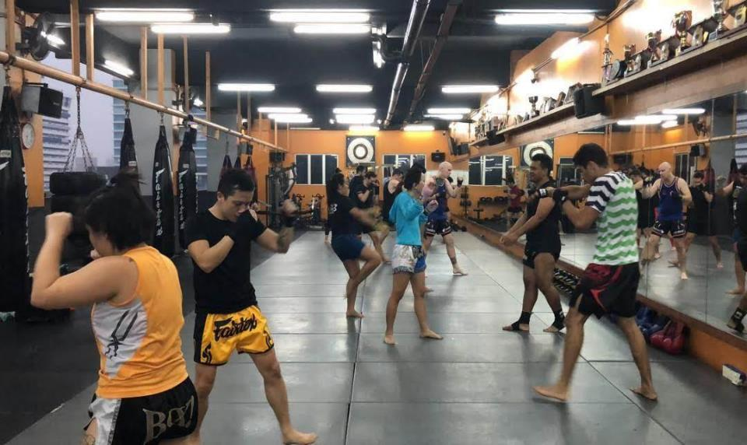
Discover Muay Thai

Slide 6
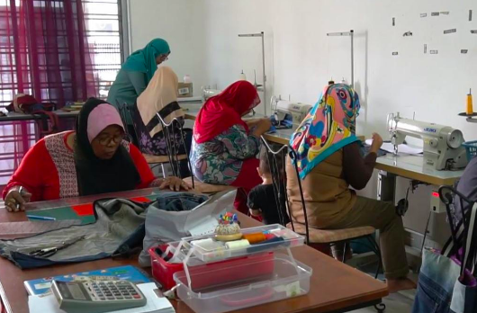
Suri- 2nd Chance

Slide 7
Scaling Up and Replicating
-facilitates deployment of packaged models developed by existing IDEs and Social Business Entrepreneurs
Capacity and Capability Development
-access to experts (Marketing, PR, Legal)
-develop SOPs and best practices palatable to the beneficiaries

Slide 8
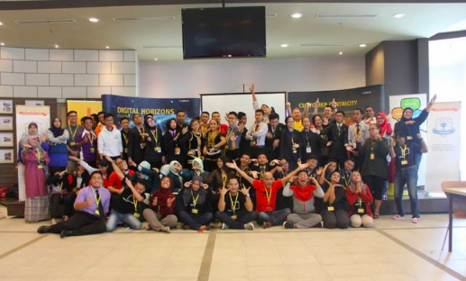
Thank You
nurfarini@myharapan.org
www.myharapan.org
Fb: myHarapan

