Slide 1
How to be more impact driven and the benefit of getting accredited.

Slide 2
WHAT IS AN IMPACT DRIVEN ENTERPRISE?
Social mission
Target Beneficiary
Business model

Slide 3
WHY?
Generating income for another charitable/community purpose
Reducing reliance on grants and donations
Meeting a community need
To advance or achieve a specific social mission
Being the change’ by demonstrating better way of doing business

Slide 4
SOCIAL IMPACTS
Employment for the marginalised
Equality & empowerment
Pollution & waste management
Income/
productivity growth
Community Development

Slide 5
COMMON BUSINESS MODELS
CROSS SUBSIDISATION
INCLUSIVE BUSINESS
ONE FOR ONE
MICRO FRANCHISING
DESIGN FOR EXTREME AFFORDABILITY

Slide 6
CROSS SUBSIDISATION
MISSION
Become the lead community-based organization in Malaysia working with key affected populations on HIV and AIDS, gender identity and sexual health.
HOW
The services provided by the organisation, such as HIV testing and screening, counsellings etc are charged at normal rate for those that can afford
A portion of revenue is used to subsidise the same services for the unfortunate who cannot afford to pay the full price.

Slide 7
ONE FOR ONE
MISSION
With every product you purchase, TOMS will help a person in need.
HOW
For every shoe sold
TOMS provides one pair of shoes to a child in need

Slide 8
INCLUSIVE BUSINESS
MISSION
To facilitate the process of social integration for people with disabilities and aims to change mindsets on disability and diversity.
HOW
Empower the blind and visually impaired community in Malaysia
Incorporate a preferential hiring policy, where majority of the staff employed is from the blind and visually impaired community

Slide 9
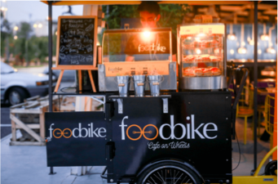
MICRO-FRANCHISING
MISSION
Providing employment opportunities for the B40s by training them to become entrepreneurs.
HOW
To empower the marginalised community to become business owners
Replicate and franchise their food truck, allowing the b40 community to become the franchise owner

Slide 10
DESIGN FOR EXTREME AFFORDABILITY
MISSION
To alleviate the health quality of mothers and children by providing innovative solutions
To solve issue of equal access and affordability
Redesign a product/service to make it more affordable

Slide 11
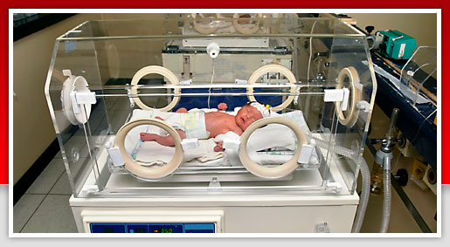
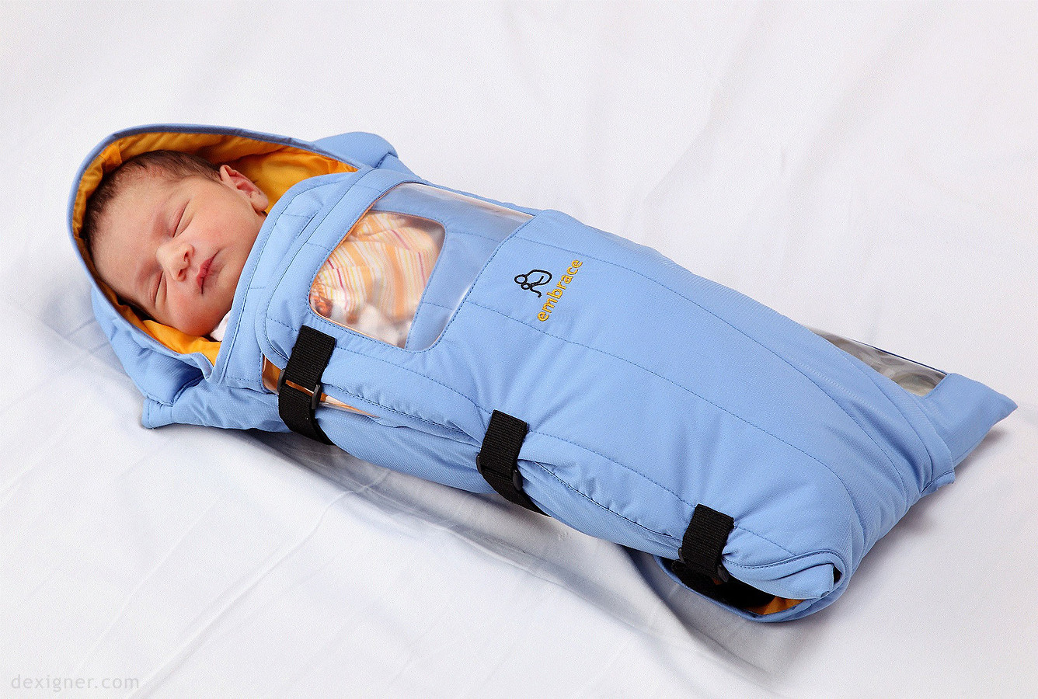
Incubator
Warm/controlled temperature
$20,000
Embrace
Low-cost infant warmer
$25

Slide 12
ADDITIONAL BUSINESS MODELS
Profit redistribution
Environment Focused

Slide 13
OVERVIEW OF IDEA
MaGIC’s Impact Driven Enterprise Accreditation (IDEA) Program aims to create systemic shift by involving private and public sectors to drive social procurement and impact projects as part of their activities.
Public & Private Sectors
Impact Driven Enterprises (IDEs)
These sectors have the means & capital to create income for those who have been engaged to be part of the supply chain
These enterprises offer services and products with the intention of earnings made will benefit a certain community
Biz procurement & Corp social Investments/ Responsibility
Goods and/or services
Impact Driven Enterprises

Slide 14
IDEs CRITERIA FOR IDEA
IDEs must be able to produce evidence to meet the following criteria; and be procurement-ready.
Criteria 1:You have a clearly stated social or environmental goal on your public documents, marketing collaterals and/or your company constitution
Criteria 2:
You contribute significant resources to your social mission by an allocation of at least:
51% of workforce is from disadvantaged groups; or
SOCIAL OR ENVIRONMENTAL IMPACT
35% of your business cost is channeled towards providing income, training or subsidized goods or services to disadvantaged groups; and/or
35% of your production raw materials or resources is spent on achieving your environmental mission; and/or
51% of your profits is distributed towards solving your social mission.
AND
FINANCIAL SUSTAINABILITY
Criteria 3: Majority of your total annual revenue is earned by business transactions (income to grant ratio 51:49); or for start-ups, you plan to work towards this revenue model.

Slide 15
IMPACT PARTNERS IN IDEA
Impact partners are institutions who commit to social procurement from IDEs accredited by IDEA. Periodic impact report outlining the partner’s procurement activities and impact achieved will be provided to the Impact Partners.

Slide 16
Up to Date MaGIC IDEA & Social Procurement Value Creation
Employment for the Marginalised / income & Productivity Growth
64 SUSTAINED JOBS
that impacting the lives of B40 youth & youth at risk,B40 women as well as disabled community (OKU)
RM 136,000
INCOME
generated for the
relevant beneficiary groups
Social
Procurement value:
RM 1.8 mil
Pollution , Waste Management & Environment Sustainability
Total estimated social
procurement/
impact projects
(not accounted for) :
RM 4.5 mil
5134 Metres
of upcycling materials saved from landfills due to repurpose & upcycling activities
718 KGs
of used cooking oil & perishable foods being repurposed/ saved from environment externalities
121 TREES planted involving indigenous areas & reserved plantations

Slide 17
IMPACT CANVAS
Mission | Impact | Product/ Services | Business Model
What problem are you trying to solve, or change do you aspire to see? Identify the changes you hope to see as a result of your activities | Who are your target beneficiaries and what benefits you wish to create for them? Be specific (eg. demographics, key stakeholders, geography) | What products/ services do you offer? Identify the products/ services you wish to offer as the source of your revenue | Which business model suits your idea best? Identify the right business model for that will fully utilise your resources to impact your beneficiaries
 | Barriers What are the barriers/concern you will face | Barriers What are the barriers/concern you will face | Barriers What are the barriers/concern you will face

