Slide 1
Ashran Dato’ Ghazi, MaGIC CEO
22nd October 2018

Slide 2
Vision
Leading Global Creativity & Innovation Centre for Entrepreneurs
Mission
To build a sustainable entrepreneurship eco system
To catalyse Creativity & Innovation for long term nation impact
Notes:
Set up as the entrepreneurship ecosystem enabler
MaGIC Social Entrepreneurship established to help SE ecosystem
RM20mil allocated to develop the SE sector

Slide 3
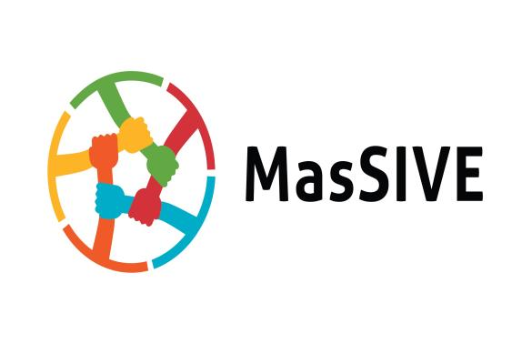
Malaysia Social Inclusion & Vibrant Entrepreneurship (MasSIVE) aims to : drive social and economic impact through entrepreneurial related initiatives that are outward looking and cohesive to ecosystem players
Malaysia’s Social Inclusion & Vibrant Entrepreneurship
In collaboration with:

Slide 4
The Story So Far & Aspiration 2018
Aims to create a sector which is sustainable, equitable and people centric to empower impact driven entrepreneurs.
2017
2016
2015
Thrust 1: Inspire a movement
Thrust 2: Create an enabling environment
Thrust 3: Effect systemic changes
Regional leaders
~ 8000 individuals via various outreach programs
~ 80 Impact Driven enterprises nurtured
~ RM 1Mil
public/
private investments
IDEA
growth through market led approach
Exponential scale up & rapid growth
10 X
FY 2018-2020
800 Impact Driven enterprise Accredited and / or within radar
~ RM 100 million public/ private sector capital for sector development
Mass national / ASEAN strategic initiatives (micro entrepreneurship & IDEA Scale up)

Slide 5
What is Social Entrepreneurship or Impact Driven Entrepreneurship?

Slide 6
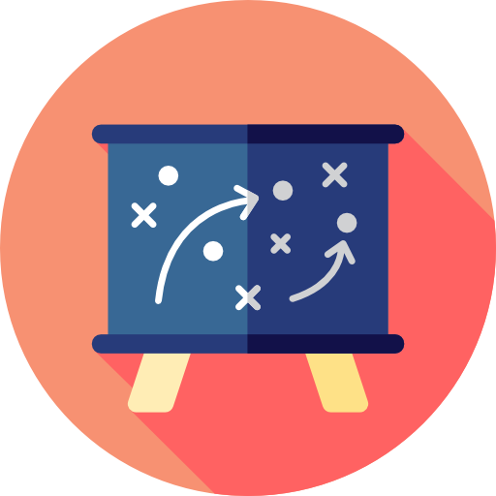
Business model
Social mission
Beneficiary
Notes:
A Social Enterprise must have the following 3 key factors:
Social Mission- Why did you establish your enterprise? Social mission is when you see a social problem in the society and you feel you have a solution for this problem, so you create your enterprise to solve this problem and give back to society. But bear in mind, when you want to give back and solve a social problem you don’t just want it to be a one-off (that is donation/charity).
That’s is why you need Business Model. A SE runs like a normal business-has a biz model, and there are 5 common types of biz model for SE which we will explain further in our slides.
Thirdly, target beneficiaries. Which is basically the people/society that you want to help out.

Slide 7
Why IMPACT DRIVEN ENTERPRISE?
Environment, sustainability, energy
Helps tackles social/ environmental issues & concerns of the nation
Offers a sustainable solution to those issues.
Helps beneficiaries to be independent & self-reliant
Economic Access
Rural development
Education
Disabilities
Healthcare
Youth Development

Slide 8
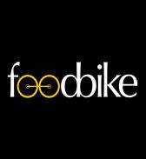
5 Common IDE Business Models
Cross Subsidisation
Buy and Give/One for One
Micro Franchising
Inclusive Business
Design for Extreme Affordability
Charging higher prices to one group of consumers in order to subsidize lower prices for another group (beneficiaries)
For each product a consumer buys, a second identical product is donated to a charitable cause
Leverages the basic concepts of traditional franchising in the developing world
Including the beneficiary in the business process that benefits the low-income communities
Design comprehensive solutions to challenges faced by the world’s poor

Slide 9
IDEA
Impact-Driven Enterprise Accreditation
REALISING AN INCLUSIVE ECONOMY THROUGH ADVANCING
THE DEVELOPMENT OF THE IMPACT DRIVEN ENTERPRISE SECTOR

Slide 10
OVERVIEW OF IDEA
MaGIC’s Impact Driven Enterprise Accreditation (IDEA) Program aims to create systemic shift by involving private and public sectors to drive social procurement as part of their activities.
Public & Private Sectors
Impact Driven Enterprises (IDEs)
These sectors have the means & capital to create income for those who have been engaged to be part of their supply chain.
These enterprises offer services and products with the intention of earnings made will benefit a certain community
Business procurement
Goods and/or services.
Beneficiary groups

Slide 11
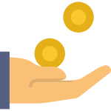
IDEs CRITERIA FOR IDEA
IDEs must be able to produce evidence to meet the following criteria; and be procurement-ready.
Criteria 1:You have a clearly stated social or environmental goal on your public documents, marketing collaterals and/or your company constitution
Criteria 2:
You contribute significant resources to your social mission by an allocation of at least:
51% of workforce is from disadvantaged groups; or
SOCIAL OR ENVIRONMENTAL IMPACT
35% of your business cost is channeled towards providing income, training or subsidized goods or services to disadvantaged groups; and/or
35% of your production raw materials or resources is spent on achieving your environmental mission; and/or
51% of your profits is distributed towards solving your social mission.
AND
FINANCIAL SUSTAINABILITY
Criteria 3: Majority of your total annual revenue is earned by business transactions (income to grant ratio 51:49); or for start-ups, you plan to work towards this revenue model.

Slide 12
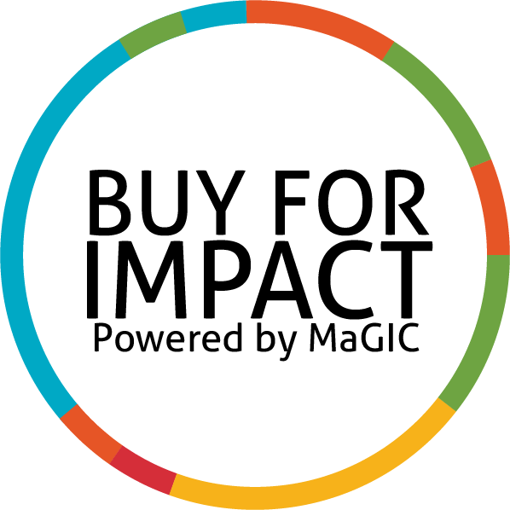
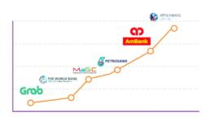
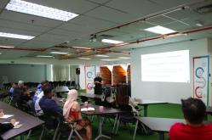
BENEFITS OF IDEA
Buy for Impact Campaign
Social Procurement Opportunities
Cap Dev classes
Pemangkin Usahawan Sosial Hebat

Slide 13
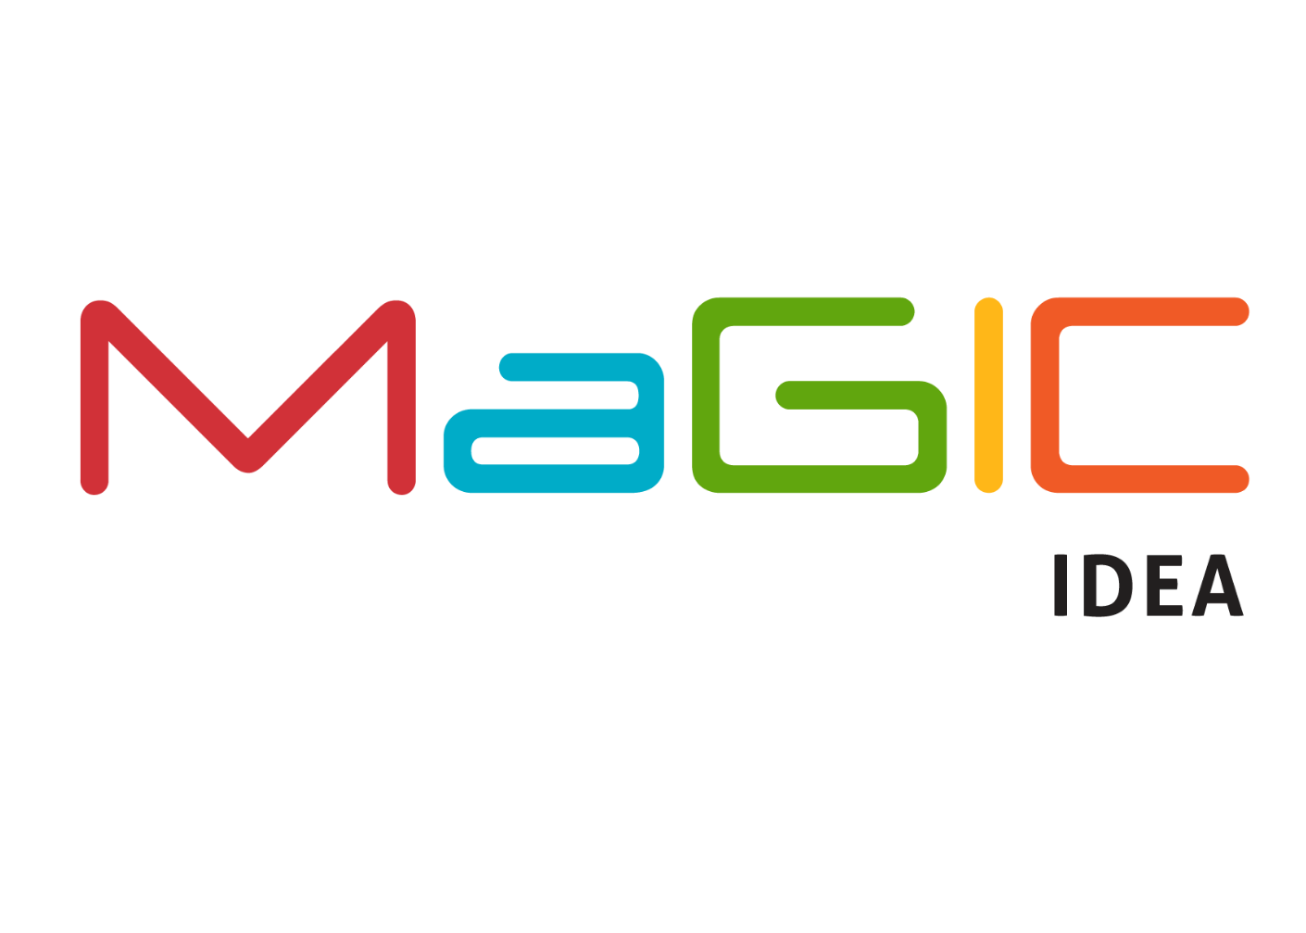
Up to Date MaGIC IDEA &
Social Procurement Value Creation
Employment for the marginalised / income & Productivity Growth
64 SUSTAINED JOBS
that impacting the lives of B40 youth & youth at risk,B40 women as well as disabled community (OKU)
RM 135,717
INCOME
generated for the
relevant beneficiary groups
Social
Procurement value:
RM 1.8 mil
Pollution , Waste Management & Environment Sustainability
5134 Metres
of upcycling materials saved from landfills due to repurpose & upcycling activities
718 KGs
of used cooking oil & perishable foods being repurposed/ saved from environment externalities
121 TREES planted involving indigenous areas & reserved plantations

Slide 14
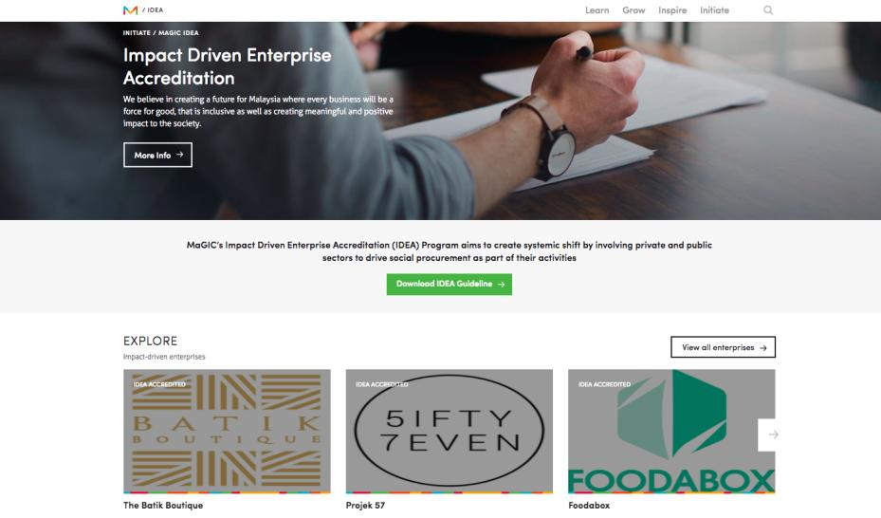

Slide 15
Thank you

